Slide 1
Structures that Control Flow
Section 1
Chapter 3
© 2016 Pearson Education, Ltd. All rights reserved.

Slide 2
Relational and Logical Operators
A condition is an expression
  Involving relational operators (such as < and >=)
  Logical operators (such as and, or, and not)
  Evaluates to either True or False
Conditions used to make decisions
  Control loops
  Choose between options
© 2016 Pearson Education, Ltd. All rights reserved.

Slide 3
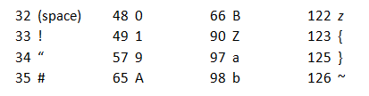
ASCII Values
ASCII values determine order used to compare strings with relational operators.
Associated with keyboard letters, characters, numerals
  ASCII values are numbers ranging from 32 to 126.
A few ASCII values.
© 2016 Pearson Education, Ltd. All rights reserved.

Slide 4

ASCII Values
The ASCII standard also assigns characters to some numbers above 126.
A few of the higher ASCII values.
Functions chr(n) and ord(str) access ASCII values
© 2016 Pearson Education, Ltd. All rights reserved.

Slide 5
Relational Operators
Relational operator less than (<) can be applied to
  Numbers
  Strings
  Other objects
For strings, the ASCII table determines order of characters
© 2016 Pearson Education, Ltd. All rights reserved.

Slide 6
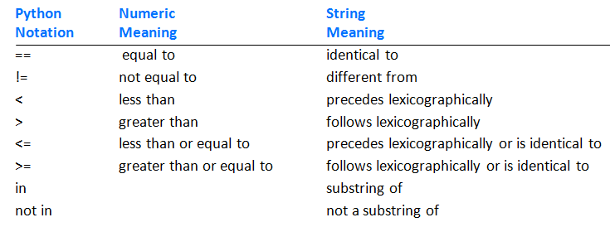
Relational Operators
Table 3.3 Relational operators.
© 2016 Pearson Education, Ltd. All rights reserved.

Slide 7
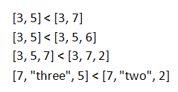
Relational Operators
Some rules
  An int can be compared to a float.
  Otherwise, values of different types cannot be compared
  Relational operators can be applied to lists or tuples
© 2016 Pearson Education, Ltd. All rights reserved.

Slide 8
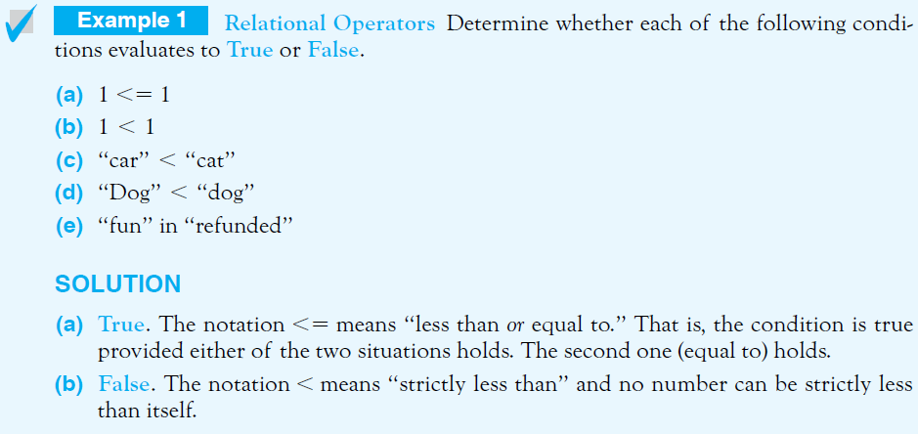
Relational Operators
© 2016 Pearson Education, Ltd. All rights reserved.

Slide 9
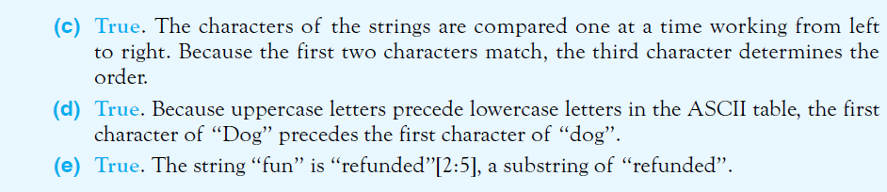
Relational Operators
© 2016 Pearson Education, Ltd. All rights reserved.

Slide 10
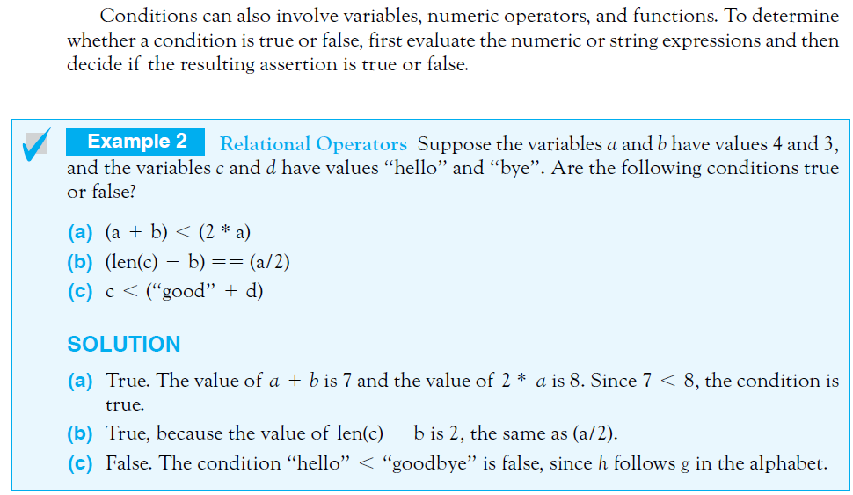
Relational Operators
© 2016 Pearson Education, Ltd. All rights reserved.

Slide 11
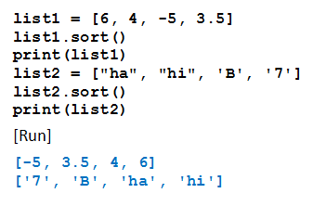
Sorting the Items in a List
Items in a list of items having same data type can be ordered with the sort method
Example 3: Program illustrates how Python orders two simple lists
© 2016 Pearson Education, Ltd. All rights reserved.

Slide 12
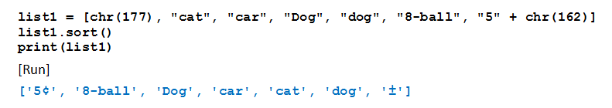
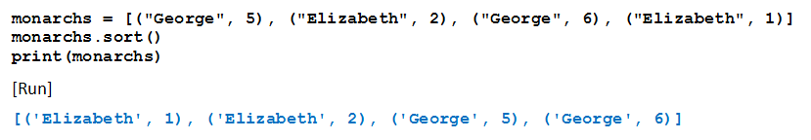
Sorting the Items in a List
Example 4: Items in a complicated list of strings.
Example 5: Items in a list of tuples
© 2016 Pearson Education, Ltd. All rights reserved.

Slide 13
Logical Operators
Enables combining multiple relational operators
Logical operators are the reserved words and, or, and not
Conditions that use these operators are called compound conditions
© 2016 Pearson Education, Ltd. All rights reserved.

Slide 14
Logical Operators
Given: cond1 and cond2 are conditions
  cond1 and cond2 true only if both conditions are true
  cond1 or cond2 true if either or both conditions are true
  not cond1 is false if the condition is true, true if the condition is false
© 2016 Pearson Education, Ltd. All rights reserved.

Slide 15
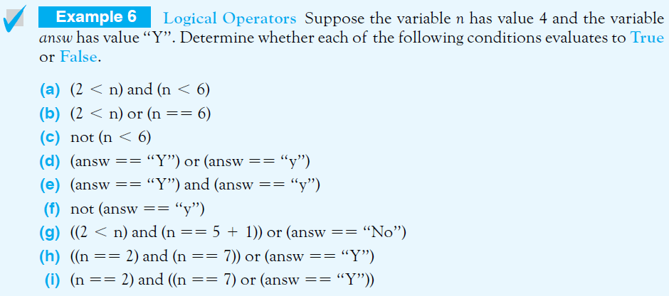
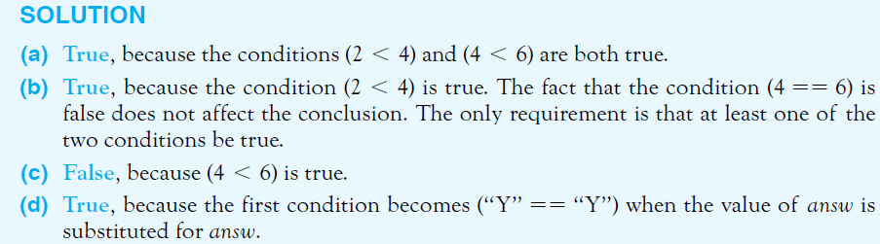
Logical Operators
© 2016 Pearson Education, Ltd. All rights reserved.

Slide 16
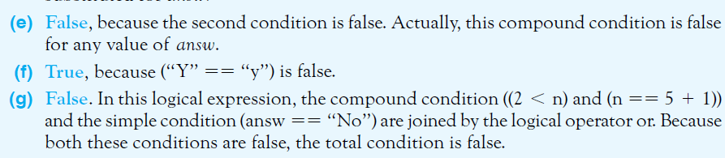

Logical Operators
© 2016 Pearson Education, Ltd. All rights reserved.

Slide 17
Short-Circuit Evaluation
Consider the condition cond1 and cond2
  If Python evaluates cond1 as false, it does not bother to check cond2
Similarly with cond1 or cond2
  If Python finds cond1 true, it does not bother to check further
Think why this feature helps for
(number != 0) and (m == (n / number))
© 2016 Pearson Education, Ltd. All rights reserved.

Slide 18
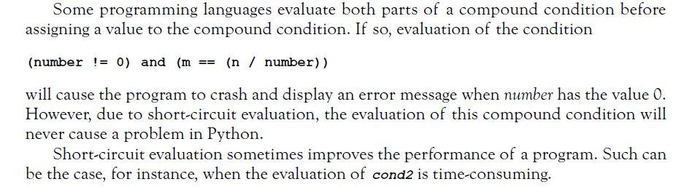
Short-Circuit Evaluation
© 2016 Pearson Education, Ltd. All rights reserved.

Slide 19
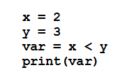

The bool Data Type
Objects True and False are said to have Boolean data type
  Of data type bool.
What do these lines display?
True
False
© 2016 Pearson Education, Ltd. All rights reserved.

Slide 20
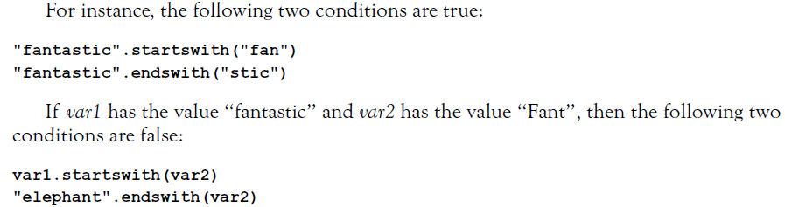
Methods that Return Boolean Values
Given: strings str1 and str2
  str1.startswith(str2)
  str1.endswith(str2)
© 2016 Pearson Education, Ltd. All rights reserved.

Slide 21
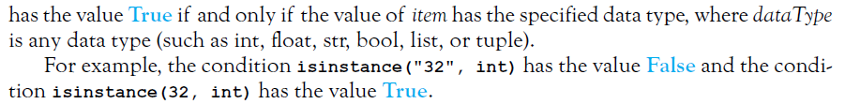
Methods that Return Boolean Values
For determining the type of an item
  isinstance(item, dataType)
© 2016 Pearson Education, Ltd. All rights reserved.

Slide 22
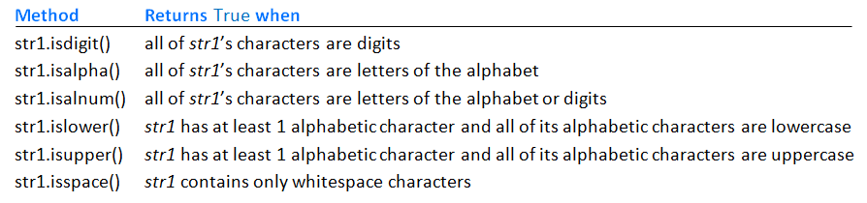
Methods that Return Boolean Values
Methods that return either True or False.
Table 3.4 Methods that return either True or False.
© 2016 Pearson Education, Ltd. All rights reserved.

Slide 23
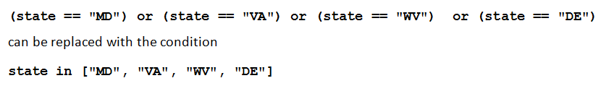
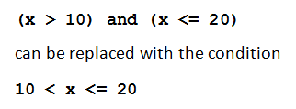
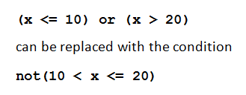
Simplifying Conditions
Lists or tuples can sometimes be used to simplify long compound conditions
© 2016 Pearson Education, Ltd. All rights reserved.

Slide 24
Simplifying Conditions
Use of De Morgan’s Laws
not(cond1 and cond2)
is the same as
not(cond1) or not(cond2)
not(cond1 or cond2)
is the same as
not(cond1) and not(cond2)
© 2016 Pearson Education, Ltd. All rights reserved.

Slide 25
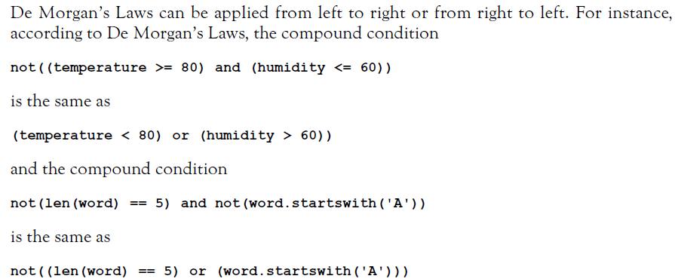
Simplifying Conditions
© 2016 Pearson Education, Ltd. All rights reserved.

Slide 26
End
Section 1
Chapter 3
© 2016 Pearson Education, Ltd. All rights reserved.

